Slide 1
Network intrusion detection
Tatyana Shishkova

Slide 2

About me
Tatyana Shishkova
Malware Analyst, Shift AV Analysts Group

Slide 3


Network intrusion detection system
Open source:
snort.org
suricata-ids.org

Slide 4
Network intrusion detection system
Monitors inbound and outbound traffic
Analyses passing traffic (scans with a set of rules)
Identifies attack / abnormal behavior
Sends an alert

Slide 5
ways of using nids
Scanning traffic from unknown objects on sandbox for automatic detection
Scanning live traffic in corporate network

Slide 6

KATA
Complex system for attack detection
Perimeter protection
Contains NIDS Snort/Suricata
Network sensors placed on network nodes
Configured for a client

Slide 7
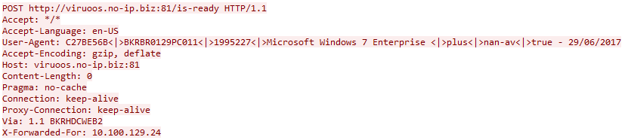
Known malicious behavior: Dinihou worm
Traffic dump

Slide 8
Known malicious behavior: Dinihou worm
Malicious indicators in traffic
HTTP POST request
“/is-ready” relative address
User-Agent contains information about infected machine
Host contains port number

Slide 9
Known malicious behavior: Dinihou worm
How to create Snort/Suricata rule?
Variant 1
alert tcp $HOME_NET any -> $EXTERNAL_NET $HTTP_PORTS \
(msg:"Dinihou worm"; flow:established,to_server; \
content:"POST"; http_method; \
uricontent:"/is-ready"; \
pcre:"/is-ready HTTP/"; \
classtype:worm; sid:01; rev:1;)

Slide 10
Known malicious behavior: Dinihou worm
How to create Snort/Suricata rule?
Variant 2
alert tcp $HOME_NET any -> $EXTERNAL_NET $HTTP_PORTS \
(msg:"Dinihou worm"; flow:established,to_server; \
content:"POST"; http_method; \
content:"User-Agent:"; http_header; \
content:"|3c 7c 3e|nan-av|3c 7c 3e|"; http_header; \
classtype:worm; sid:02; rev:1;)

Slide 11
Known malicious behavior: Dinihou worm
How to create Snort/Suricata rule?
Variant 3
alert tcp $HOME_NET any -> $EXTERNAL_NET any \
(msg:"Dinihou worm"; flow:established,to_server; \
content:"POST "; depth:5; \
content:"/is-ready HTTP/"; within:15; nocase; \
classtype:worm; sid:03; rev:1;)

Slide 12
Rules for dns queries
example.com
alert udp $HOME_NET any -> any 53 \
(msg:"example.com DNS query"; \
content:"|01 00 00 01 00 00 00 00 00 00|"; \
depth:10; offset:2; \
content:"|07|example|03|com|00|"; nocase; \
distance:0; fast_pattern; \
classtype:test; sid:04; rev:1;)

Slide 13
snort rules creating Step 1. DNS query for known malicious domain
www.bizagree.com – Trojan-Spy.Win32.Noon C&C
alert udp $HOME_NET any -> any 53 \
(msg:"Malicious domain request"; \
content:"|01 00 00 01 00 00 00 00 00 00|"; \
depth:10; offset:2; \
content:"|03|www|08|bizagree|03|com|00|"; nocase; \
distance:0; fast_pattern; \
classtype:trojware; sid:05; rev:1;)

Slide 14
snort rules Creating Step 2. generic silent rules for intercepted traffic
alert tcp $HOME_NET any -> $EXTERNAL_NET $HTTP_PORTS \
(msg:"Probably Trojan-Spy.Win32.Noon"; \
flow:to_server,established; \
content:"GET"; http_method; \
content:"/?id="; http_uri; fast_pattern; \
pcre:"/GET \/[a-zA-Z0-9\/]+\/\?id\=/"; \
content:"Host:"; http_header; \
classtype:suspicious-activity; sid:06; rev:1;)

Slide 15
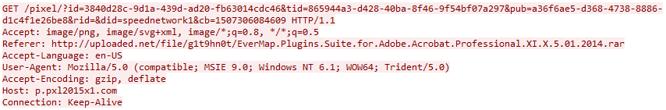
snort rules Creating Step 3. avoiding false alarms
Noon traffic:
False alarm:
content:!"Accept"; http_header; \
content:!"User-Agent:"; http_header; \
content:"Host: www."; http_header; \

Slide 16
snort rules Creating Step 4. exact regular rules for intercepted traffic

Slide 17
snort rules Creating Step 4. exact regular rules for intercepted traffic
content:"GET"; http_method; \
content:"/?id="; http_uri; fast_pattern; \
pcre:"/GET (\/[a-zA-Z0-9]{2,5}){1,}\/\?id\=[a-zA-Z0-9_\-\.\+=\/]+ HTTP\/1\./"; \
content:"Host: www."; http_header; \
content:"Connection: close"; http_header; \
content:!"User-Agent:"; http_header; \

Slide 18
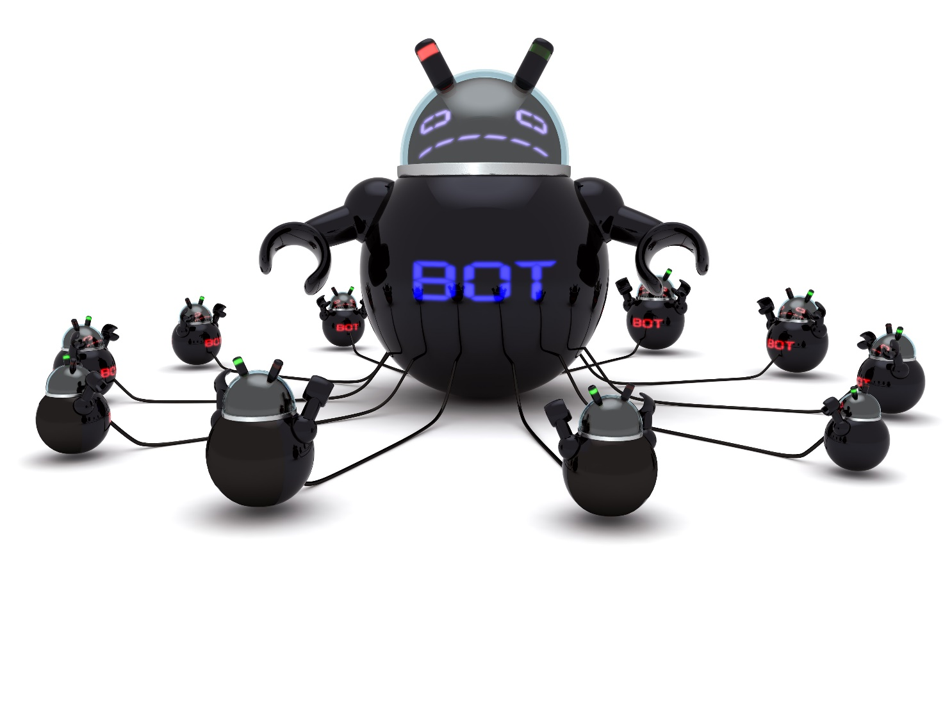
Discovering botnets using nids
Botnet
A network of ‘bots’ (infected machines) that the criminal can remotely manage

Slide 19
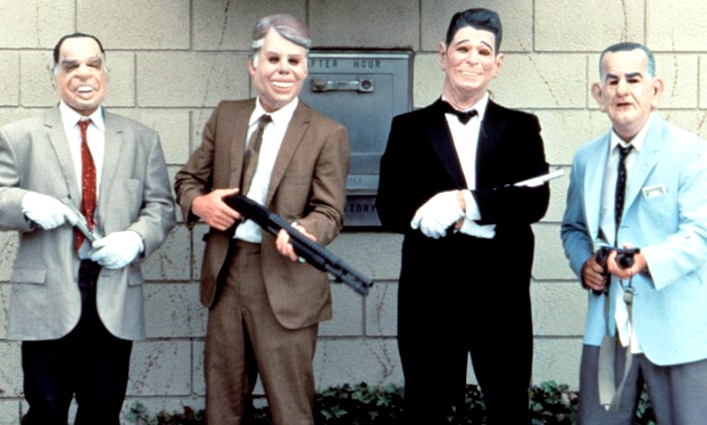
FIBBIT (RANBYUS) BANKING TROJAN
Known since March 2010
Remote control of BIFIT iBank 2 banking client and others
Different versions
Latest version was active in autumn 2016

Slide 20
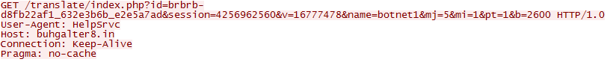
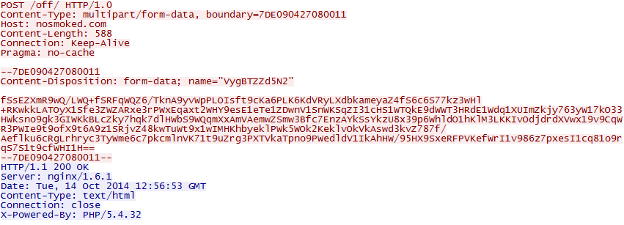
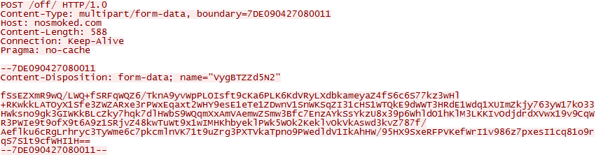
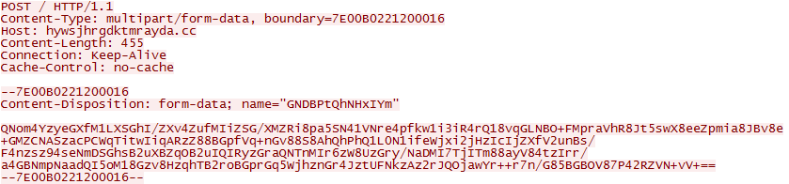
FIBBIT (RANBYUS) BANKING TROJAN
Evolution:
GET request with plain text parameters
POST request with custom base64
Added random parameter-value pairs
Different base64 alphabets
DGA
Module name

Slide 21
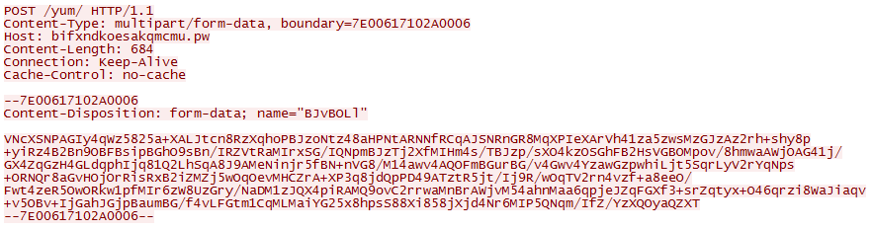
FIBBIT (RANBYUS) BANKING TROJAN
HTTP stream, August 2016
Header structure
pcre: “/-{2}[A-Z0-9]{15}\x0d\x0a
Content-Disposition: form-data\;
name=\"[A-Za-z0-9]{7,18}\"
\x0d\x0a\x0d\x0a
[A-Za-z0-9+\/]{100,}={0,2}\x0d\x0a-{2}[A-Z0-9]{15}-{2}/”;

Slide 22
FIBBIT (RANBYUS) BANKING TROJAN
Custom base64 encryption
9h4=niNkMPvaT8eCJAHh2TVtPJ91&hXfMVR9XjEYlEyJR=arLUISNfkJu8CgfXYs2YM
&id=DC1-VD-DVM032_c834d116_32bac8ae&mj=6&mi=1&pt=1&b=7601&dc=64&v=18023936
&J7aQ=rZGwjS6wXOCcQ6H50zRA&uEgl0D=JUIzIidrwXq1d295X&session=1051675776
&eq6dpDAthOSPm8=bQi3CaVoUeOr6wmEG1j04c&7ase6krHz=iCNJQWznNn5zpdaatf&uqXse08=r7vqBUZkf8pcYhXvsaBry1&module=main&vRoCdDZImz7x=urRr3ZGwra6Q2&YoRGZJ58OLJC=cPkjCcoSVQTyRFU7Cxv3t&u9DI7d2P=1617pxLogyBA&TbL8jTI3=UtEXUwGz5mo&name=blcb&token=0

Slide 23
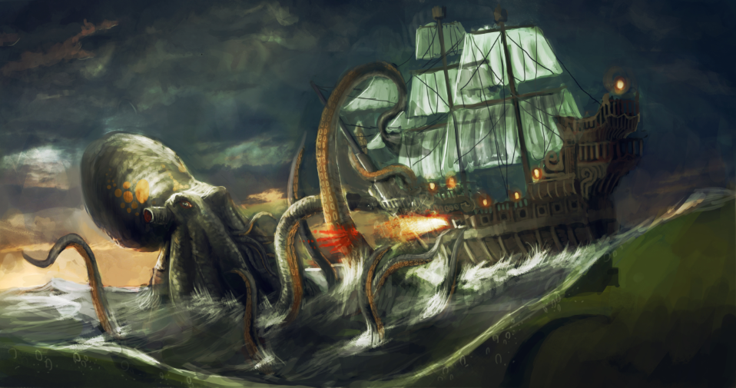
BETABOT (NEUREVT) BOTNET
Multifunctional
Known since 2013
C++, VB crypter
Up to 16 CnC servers hardcoded
Still alive

Slide 24
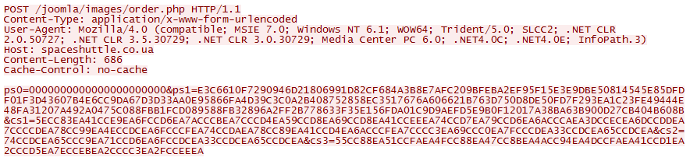
BETABOT (NEUREVT) BOTNET
POST request
Standard header
ps0 – bot key
ps1 – bot config data
cs1 – bot path
cs2 – browser name
cs3 – computer/user name
2014

Slide 25
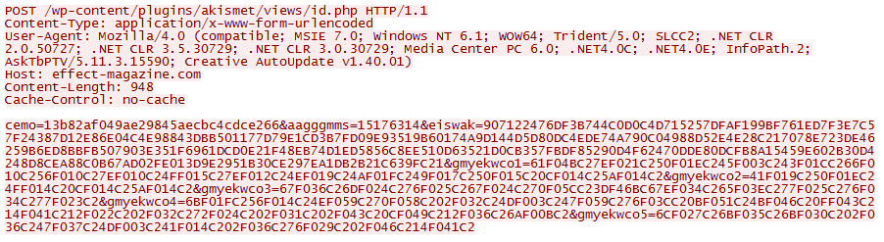
BETABOT (NEUREVT) BOTNET
POST request
Standard header
ps0 – bot key
ps1 – bot config data
cs1 – bot path
cs2 – browser name
cs3 – computer/user name
+
pseudorandom names
CPU
GPU
2016

Slide 26
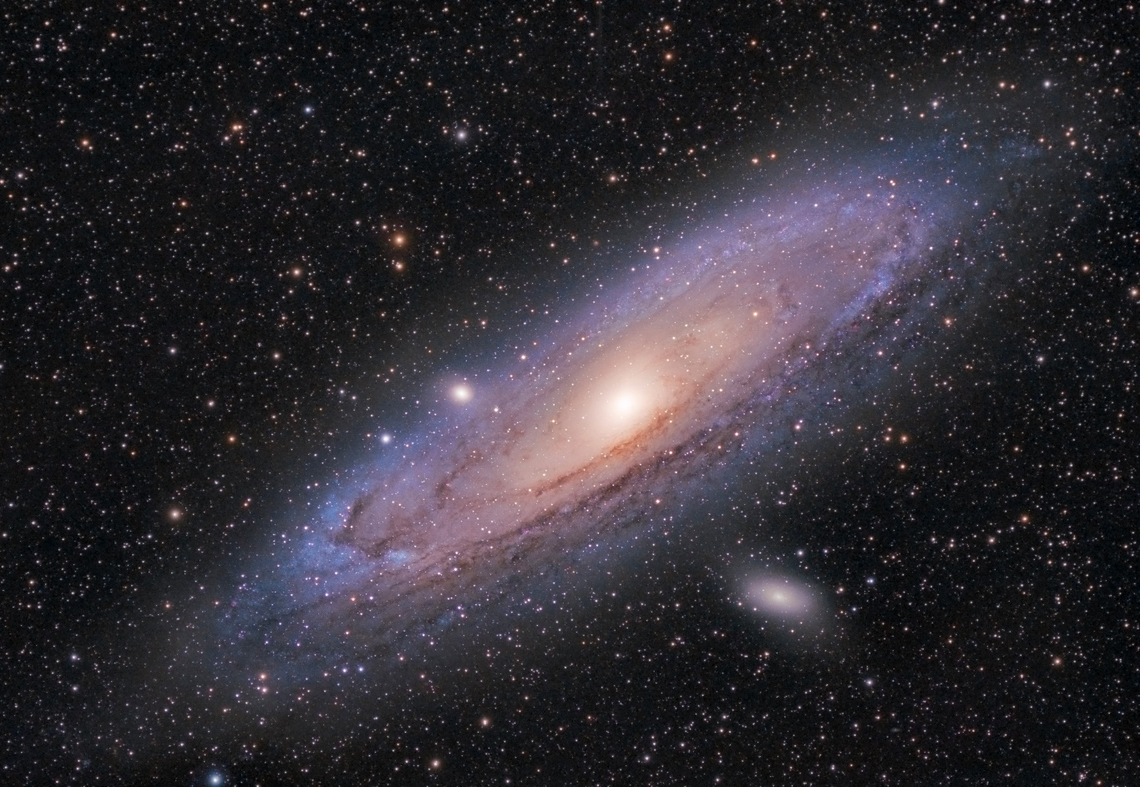
ANDROMEDA (GAMARUE) DOWNLOADER
Known since 2011
Downloads popular ZeuS, Torpig, Fareit, Lethic etc.
Multimodular (keyloggers, grabbers, proxy, rootkits)
Price: ~300-500$ + plugins

Slide 27
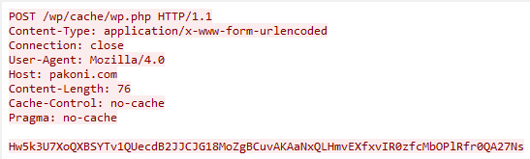
ANDROMEDA (GAMARUE) DOWNLOADER
HTTP stream, variant 1
Content (mask)
pcre:”/<base64_expression>/”

Slide 28
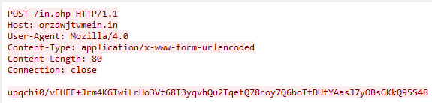
ANDROMEDA (GAMARUE) DOWNLOADER
HTTP stream, variant 2
No “Cache-Control:”
No “Pragma:”
id:<ulong> | bid:<ulong> | bv:<ulong> | sv:<ulong> | pa:<ulong> | la:<ulong> | ar:<ulong>

Slide 29
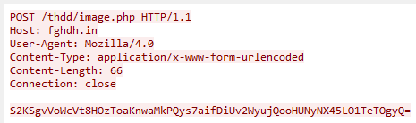
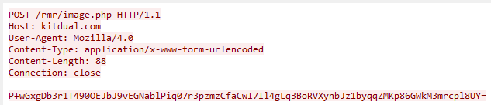
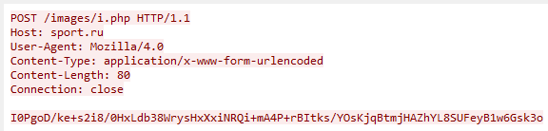
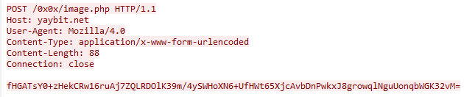
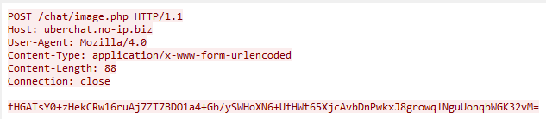
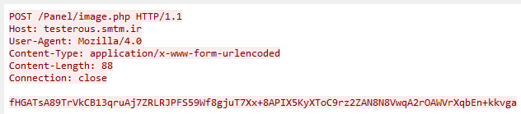
ANDROMEDA (GAMARUE) DOWNLOADER
2011
2012
2013
2014
2015
2016

Slide 30
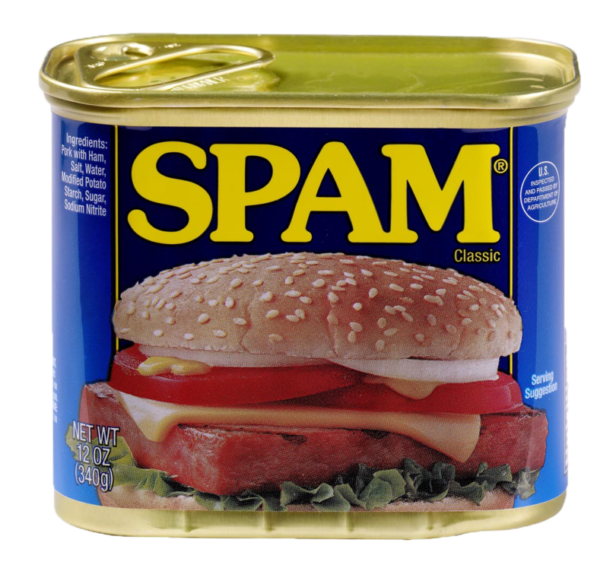
GLUPTEBA SPAM BOTNET
Known since 2011
New versions appear every day

Slide 31
GLUPTEBA SPAM BOTNET
GET request w/ plain text parameters:
GET /stat?uptime=%d&downlink=%d&uplink=%d&id=%s&statpass=%s&version=%d&features=%d&guid=%s&comment=%s&p=%d&s=%s HTTP/1.0
CnC reply:
badpass
session:<number>
+ commands

Slide 32
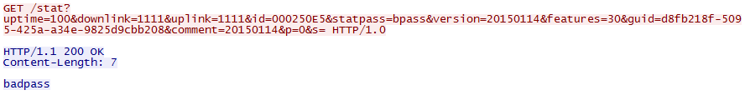
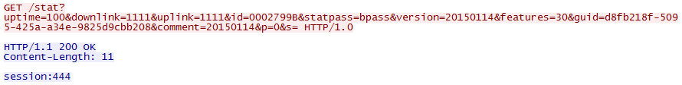
GLUPTEBA SPAM BOTNET
Try another CnC…

Slide 33
Fixing false alarms
Gh0st RAT
alert tcp $HOME_NET any -> $EXTERNAL_NET !25 \
(msg:"Gh0st Trojan CnC"; \
flow:established,to_server; dsize:<250; \
content:"Gh0st"; offset:8; depth:5; \
classtype:trojware; sid:07;)

Slide 34
Fixing false alarms
Gh0st RAT
Not Gh0st

Slide 35
Fixing false alarms
Gh0st RAT
content:"Gh0st"; offset:8; depth:5;
Fix:
content:"|00|Gh0st"; offset:7; depth:6;

Slide 36
Fixing false alarms
Psiload Backdoor
alert udp $HOME_NET any -> any 53 (msg:"Psiload Backdoor"; content:"|01 00 00 01 00 00 00 00 00 00 11|"; depth:11; offset:2; fast_pattern; pcre:"/^[A-Z0-9]{17}/R"; content:"|00 00 10|"; distance:0; classtype:suspicious-activity; sid:1;)

Slide 37
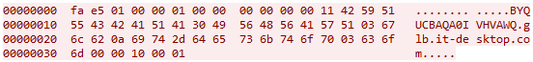
Fixing false alarms
Psiload Backdoor
BYQUCBAQA0IVHVAWQ.glb.it-desktop.com
Not Psiload
AARDVARKFINANCIAL.CO.UK
SAFETYINNOVATIONS.CA

Slide 38
Fixing false alarms
Psiload Backdoor
pcre:"/^[A-Z0-9]{17}/R"; content:"|00 00 10|"; distance:0;
Fix:
pcre:"/^[A-Z0-9]{17}/R"; content:"|03|com|00 00 10|"; distance:10;

Slide 39
Questions?
Tatyana.Shishkova@kaspersky.com

